Slide 1

Date: | Human Biology Year 12 ATAR
Do Now Get out your equipment and textbook. Lesson Agenda 1: Do Now 2: Chromosomal Mutations 3: Start on the Review Worksheet 4: Lesson summary and wind-up Suggested Study Complete review worksheet, then mark and correct using the answer key on Connect (compulsory). NEXT LESSON Changes to allele frequencies in gene pools | Learning Aims Define chromosomal mutation List and describe chromosomal mutation types List cause and features for the following chromosomal disorders Down Syndrome Patau Syndrome Klinefelter’s Syndrome Cri-du-chat Syndrome Turner’s Syndrome List methods for in-utero detection of chromosomal abnormalities
 | Key Vocabulary Deletion Duplication Inversion Translocation Aneuploidy

Slide 2
Chromosomal Mutations
Involve all or part of a chromosome
Occur during meiosis
Affect many genes, rather than one
Several types
Deletion: part of chromosome is lost
Duplication: part is doubled – occurs twice
Inversion: part is flipped
Translocation: part breaks off and joins to another chromo
Non-disjunction: extra chromo (trisomy), or one less (monosomy). Aneuploidy means change in number of chromos.
Cause (often severe) abnormalities or death in utero
Learning Aim: Define Chromosomal Mutation

Slide 3
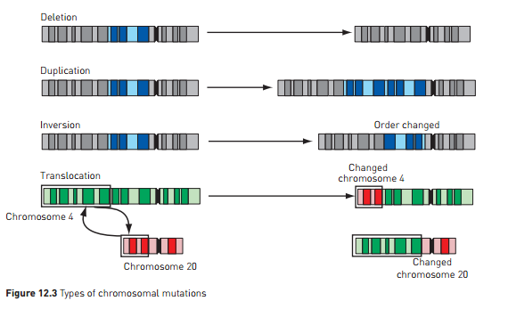
Chromosomal Mutation Types
In addition to these is aneuploidy where the chromosomes do not separate correctly during Meiosis I or II, resulting an abnormal chromosome number
Learning Aim: List and Describe Chromosomal Mutation Types

Slide 4
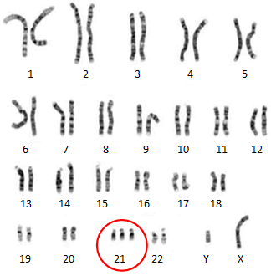
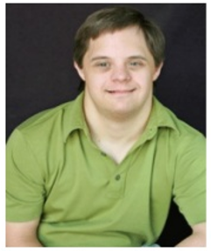
Example: Down Syndrome
Trisomy 21:
Aneuploidy
3 copies of Chromosome 21, rather than only 2.
Due to non-disjunction during meiosis
Some features can also occur with partial trisomy:
Extra copy of some of chromo 21 gets translocated.
Features:
Characteristic facial features
Low muscle tone
Intellectual disability (not in every case)
Heart defects (in some cases)
Learning Aim: List causes and features of Down Syndrome

Slide 5
Example: Patau Syndrome
Extra chromosome 13 (Trisomy 13)
1 in 5000 live births
Affected babies usually die within a month of birth
Range of serious physical defects to facial features, heart, body systems, brain.
Learning Aim: List causes and features of Patau Syndrome

Slide 6
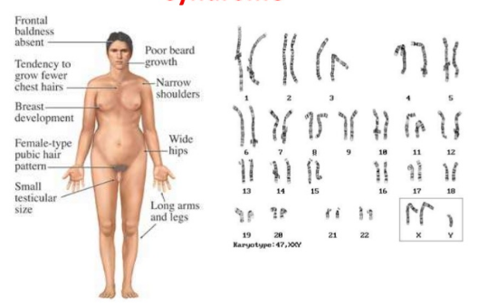
Example: Klinefelter’s Syndrome
Affects Chromo 23 (sex chromosomes)
XXY
Male external characteristics
Typical features start at puberty:
Small testes, no sperm produced
Enlargement of breasts
Less body hair
Sometimes intellectual disability
Learning Aim: List causes and features of Klinefelter’s Syndrome

Slide 7
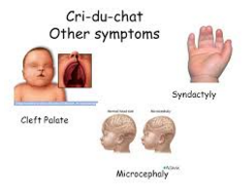
Example: Cri-du-chat syndrome
Partial monosomy / partial chromosome deletion: part of Chromosome 5 is missing.
Name because of unusual infant cry – problems with larynx and nervous system
Features can include:
Cleft Palate
Fused/Webbed digits
Microcephaly
Intellectual Disability
Delayed growth and development
Learning Aim: List causes and features of Cri-du-chat Syndrome

Slide 8
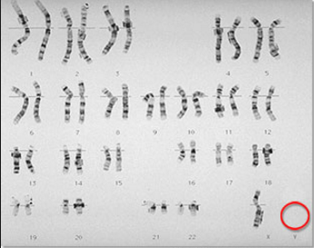
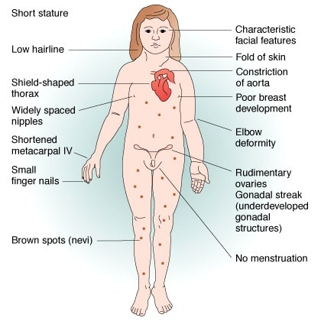
Example: Turner’s syndrome
Monosomy: missing a sex chromosome.
Only 1 X, rather than XY or XX
Physically appear female
Short stature
Lack secondary sex characteristics
Infertile
Learning Aim: List causes and features of Turner’s Syndrome

Slide 9
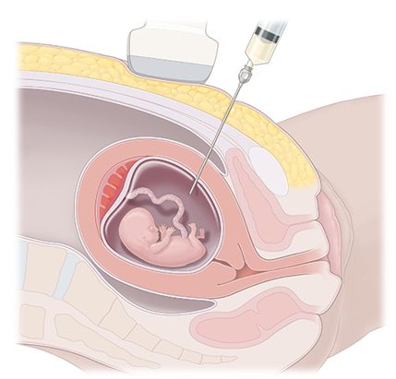
In-utero diagnosis of Chromosomal Abnormalities
By amniocentesis
Blood sample analysis
Placental sample analysis
Can provide parents with information to assist with planning for child, or decision to terminate pregnancy,
Learning Aim: List methods for in utero detection of chromosomal abnormalities.

